Slide 1
Ovia Health App
(Coding Exercise)
- By Gaurav Shah

Slide 2






https:\\ovia-health.com\api\
Gateway
Ovia Health App
Patients
?date=2021-07-20&incentivize-actions=1
App Backend
Partner FHIR
endpoint

Slide 3
Assumptions
Assuming we have cross-platform compatible or native app in place that submit log to the specific end point e.g. https:\\ovia-health.com\api\
In order to avoid any negative impact on user-experience, we can have front-end framework makes async call to submit user’s data and gracefully handles any failure or delay. In this scenario, we have used following url query to submit data e.g. ?date=2021-07-23&incentivize-actions=1
In order to quickly test and validate, I am assuming single incremental call to trigger 5 consecutive days app to earn usage-based incentive.
Also, assuming that we have continuous on-going incentive program, so this program is resetting counter to 0 once the incentive is awarded.
All end-points communicate over secured TLS 1.2 encryption, and hosted app on routinely patched servers and performed periodic update the app to make the whole system work securely and efficiently.

Slide 4
Requirements
Support different types of incentive events
User logged data five days in a row
User reported a birth
Identify and record when a user achieves a certain incentive

Slide 5
Coding
User interface to log information
API Implementation
Status block to visualize data

Slide 6
Design
I have provided form to simulate type of activity that app can monitor along with date field to allow evaluator to simulate themselves.
On right, there is status block which shows the data that’s being stored.
Counter to track consecutive reporting days gets reset when user earn an incentive.
When there is incentive bein earned, you will see success alert with green background or else it uses info alert in yellow color.

Slide 7
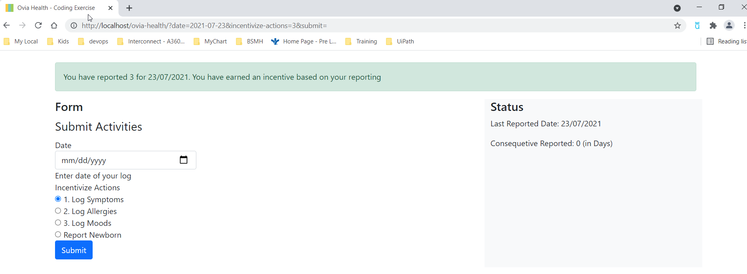
Incentive – 5 consecutive days submission

Slide 8

Incentive – on new born repoting

Slide 9
Integration
In order to share the user incentive achievements with incentive-managing partners outside of Ovia Health, we can achieve this based on various ways
Direct HER integration – HL7 interface (receive HL7 message directly from EMR system to queue and process it)
API – We can use FHIR api as it’s becoming health care’s standard as part of meaningful use. So, we can leverage this and be able to get patient’s change to the record
App Integration – We could also place our code in EMR vendor’s app store and let our managing partner integrate with thei EMR. Once we have integration in place, we can use SSO to allow patients to start using themselves.

